Slide 1

2022 NW Youth Careers Expo
Sample Teacher Assignments

Slide 2
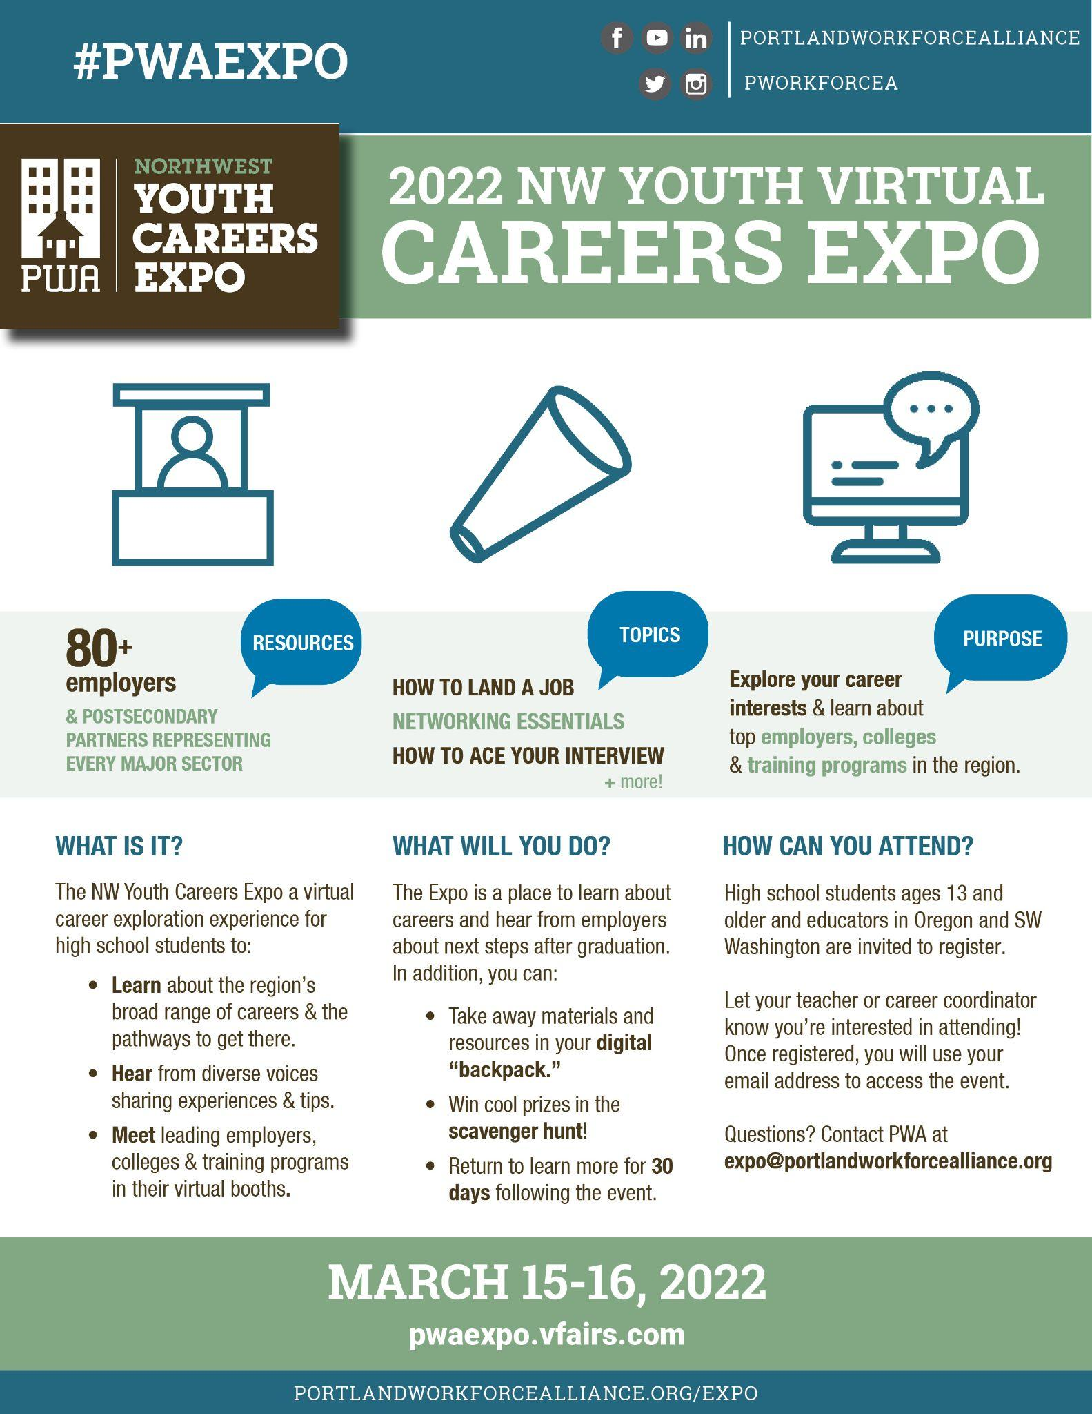
BEFORE the Expo: Setting the Stage
Share the “WHY” of the Expo
Information + Inspiration
Career readiness + career exploration
Real-world connection with amazing LOCAL employers
Share a few visuals, such as
1-minute teaser video
3ish-minute platform video guide for students
Short Student Overview (“Careers Expo 2022 Student Overview” slide deck)
All resources at www.portlandworkforcealliance.org/expo
on Educator Resources page.
Notes:
Done

Slide 3
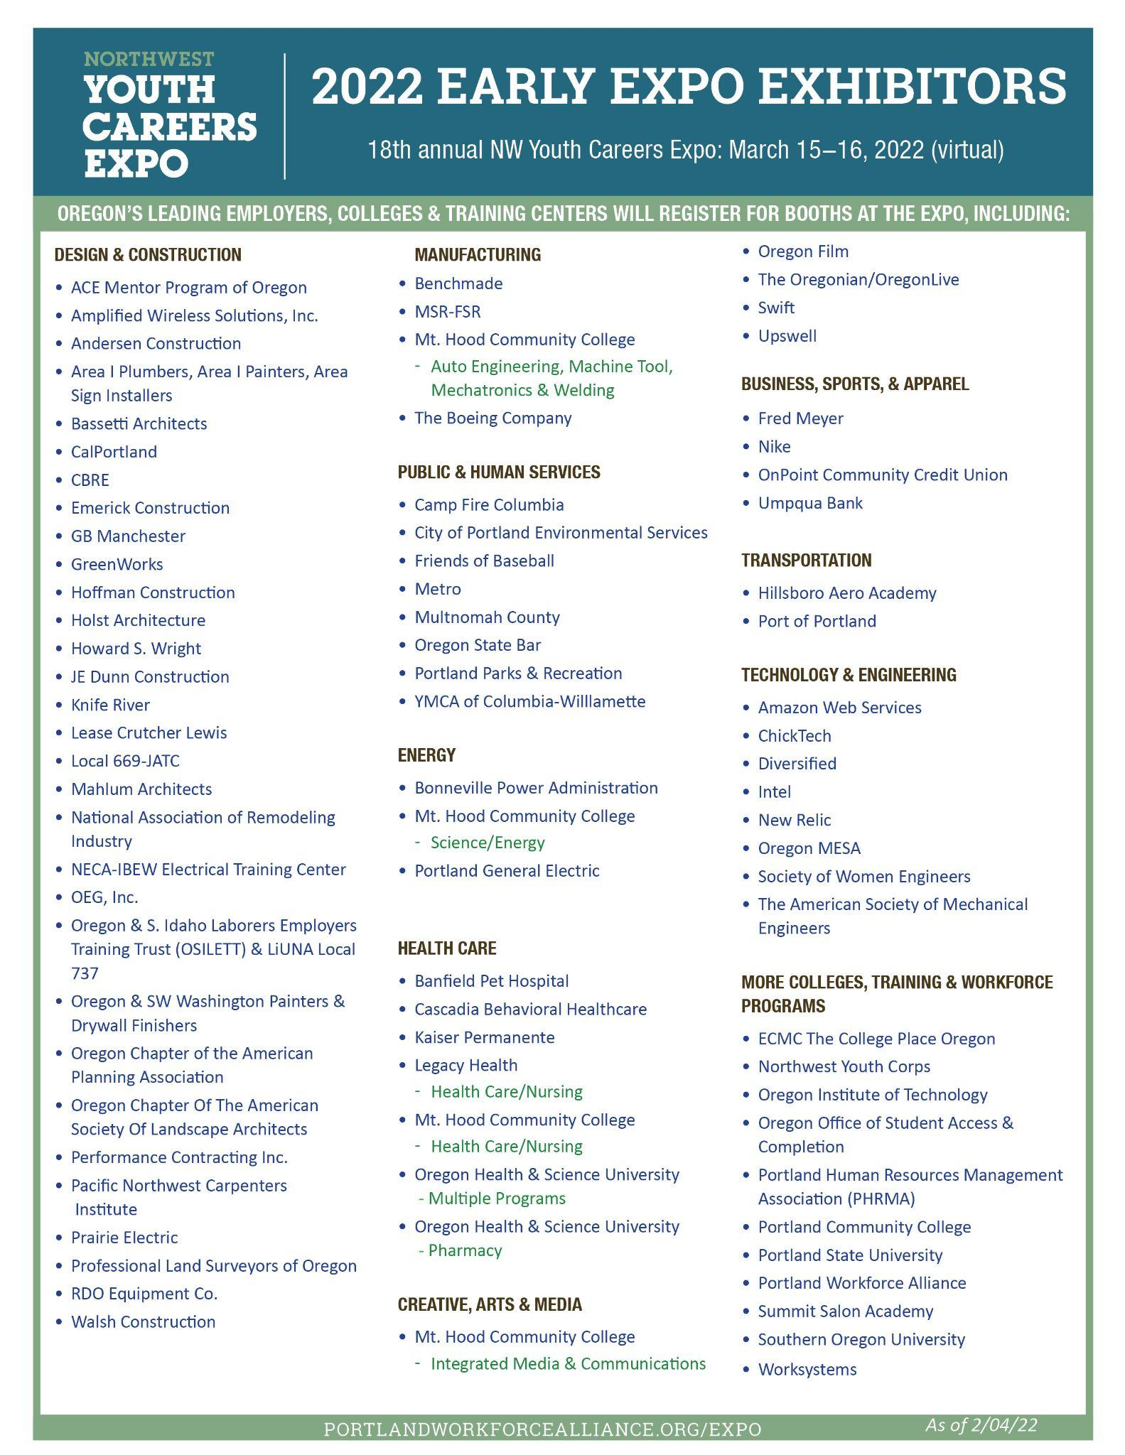
BEFORE the Expo: Career Assessment & Expo Plan
Students can take a career assessment in CIS, Naviance, Expo2Go or other online tool.
After students identify career interests, show them the list of Expo exhibitors and have them select at least five employers they want to visit.
Have students brainstorm questions for these exhibitors.
Notes:
Done

Slide 4
BEFORE the Expo: Construction Highlight
Expo exhibitors come from every major sector!
Construction is one of the strongest industries represented,
given the job growth and well-paying career opportunities.
Teachers can highlight career opportunities within this industry, including:
Architecture and Interior Design
Construction Management
Engineering
Skilled Trades
Interested students can visit multiple employers, training centers, unions and the ACE Mentor Program at the Expo to learn more about getting started.

Slide 5

DURING the Expo: In the Exhibit Halls
Ask students to visit 3-5 exhibitors in their primary area of interest, plus at least 3 outside their comfort zone.
They can attend Live Booth Talks hosted by employers, colleges & training programs.
See the Expo Resource Guide for the full list of talks.
They can ask questions in the booth Chat and Employer Chat Rooms.
They can check out booth resources, such as videos and documents, and add favorites to their “digital backpack” to email to themselves.
They can complete a reflection sharing what they learned, or share in small-group breakout sessions in class.
Booth resources and documents are available for 30 days after the live event
for asynchronous learning. Live Chat is only available during the live event.

Slide 6
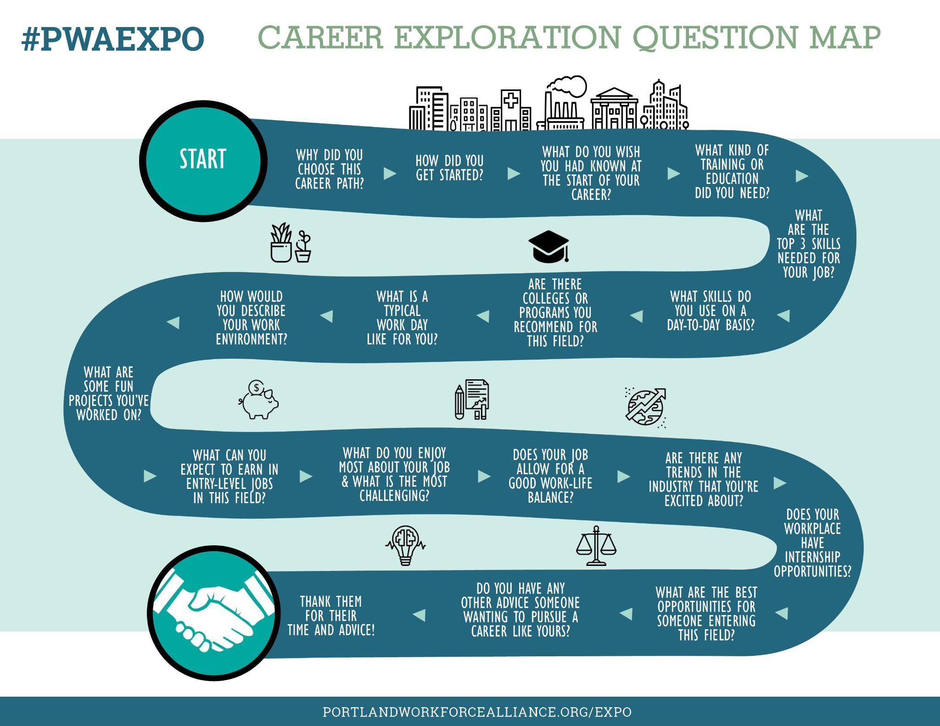
Sample Questions for Exhibitors
Notes:
Done

Slide 7

DURING the Expo: In the Auditorium
Ask students to attend 1-3 Semi-Live and/or live Booth Talks.
Topics can be informational (How to Land a Job, How to Ace Your Interview, or Networking Essentials), or inspirational.
Ask them to complete a reflection on what they learned.
All Auditorium Career Talks are recorded and available for 30 days afterward for asynchronous learning.

Slide 8
AFTER the Expo: Sample Exhibit Hall Reflection
What industry interests you the most, and why?
(See Expo Resource Guide for the list of industry spotlights.)
Name some careers within that industry.
Name 2-3 employers within this industry that stood out to you and why.
Describe 3 things you learned about this industry that you didn’t know before.
What type of education or training do you need to get started in this industry?
What do you need to advance?
What kinds of skills do you need to succeed in this industry?
(i.e. math skills, writing ability, computation skills, critical thinking, public speaking, budget analysis, project management)

Slide 9
AFTER the Expo: Sample Auditorium Reflection
Why did you choose this Career Talk?
What was the most useful piece of advice you learned?
What was one surprising or inspirational thing you learned?

Slide 10

Questions? Need more info to share with students?
Visit the Educator Resources on our site:
www.portlandworkforcealliance.org/expo
Contact expo@portlandworkforcealliance.org

